Slide 1
Programming Fundamentals
Mohammad Shahid Qureshi
NU-FAST

Slide 2
About Instructor
Contact
Office#113, first floor, EE block
Email: shahid.qureshi@nu.edu.pk

Slide 3
Course Introduction
Credit Hours: 3 (3 hours teaching + 3 hours lab per week)
Course website: Google ClassRoom
To join use code: uuyyuz5
Teaching Assistants (TA): will be communicated later

Slide 4
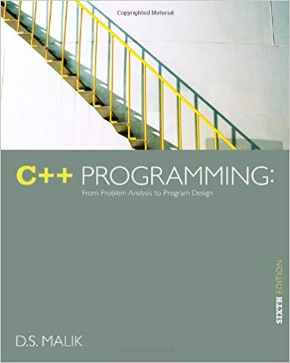
Books
C++ Programming
By DS Malik

Slide 5
Grading (tentative)
15% - Programming assignments
10% - Quizzes
10% - Sessional 1
15% - Sessional 2
50% - Final

Slide 6
Programming stream at EE
Introduction to Computing – 2+1 Cr Hr
Programming Fundamentals: 3+1 Cr Hr
Data Structures – 3+1 CrHr
Operating System (Elective for Comp Engg)
Network Programming (Elective for Comp Engg)
Other than that you will be doing programming in Matlab, Assemblly, Verilog etc in other engineering courses

Slide 7
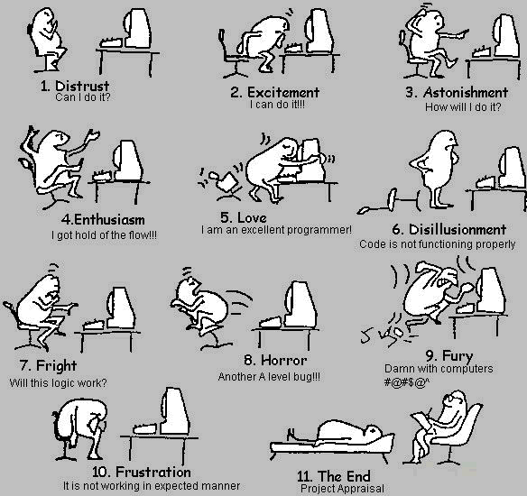
Programming stages

Slide 8
Representing Information as Bit Patterns
Everything in a computer is represented using binary numbers
Numeric values
Text
Images
voice

Slide 9
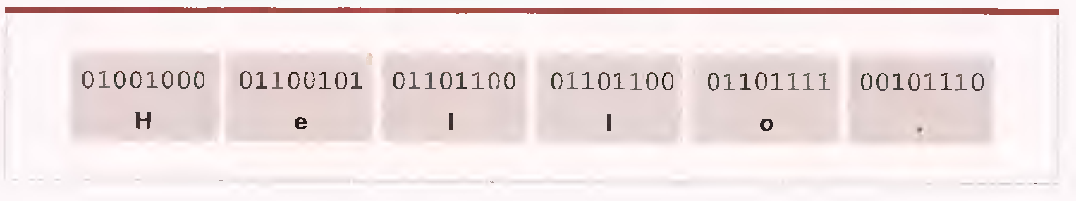
Representing Text
Text is represented by means of a code
Most common Code is ASCII
ASCII – American Standard Code for International Exchange

Slide 10
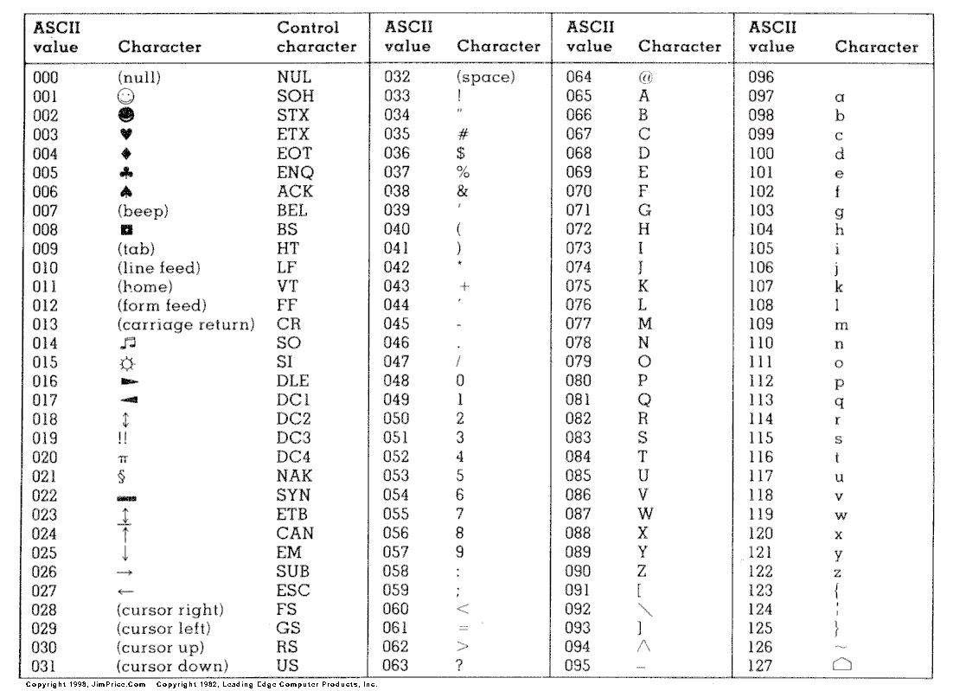

Slide 11
char Array
char arr[100];
what is a Null character ?
Note
char arrays are also called as C strings

Slide 12
Initialize string
char name[50 ] = “SHAHID”;
a null character is inserted after the last character.
Above, array length is 50 but data length is 7

Slide 13
char array INPUT
char name[50];
How to take input from the user using for loop
Or using cin without using loop
cin >> name;
cin will stop taking input, whenever we will press Enter key, and inserts a null character where input stops.
Solution is cin.getline()
for(i=0;i<50;i++)
cin>>name[i];

Slide 14
char array OUTPUT
for(i=0;i<50;i++)
cout<<name[i];
for(i=0;i<50;i++){
if(name[i]==‘\0’)
break;
cout<<name[i];
}
cout<<name;

Slide 15
We cannot do this …
We cannot assign like this:
char str1[ ] = "Hello" ;
char str2[10] ;
str2 = str1 ; /* error */
Also we cannot re-initialize a string:
char str1[ ] = "Hello" ;
str1 = "Bye" ; /* error */

Slide 16
Common operation with char arrays
Finding the cstring length
Copying one cstring to another cstring
Appending one cstring to another cstring
Comparing if two cstrings are equal or not

Slide 17
Common c-string functions
C-String provides us functions to be used with strings
int strlen(string)
Returns a number equivalent to number of characters in the string
strcat(destStr, srcStr)
destStr and srcStr are combined and stored in destStr. The destStr should be large enough to hold the combined string
strcpy(destStr, srcStr)
Copies the srcStr in destStr overwriting the contents of destStr
int strcmp(string1, string2)
An integer is returned that is -1, 0 or 1, depending on whether string1 is lexicographically less than, equal to or greater than string2

Slide 18
#include <cstring>
void main()
{
char name[80] = "Programming for Engr:";
char name2[80] = "Grade A";
int len = strlen(name);
cout<<len<<endl;
//u can write this line instead of above two lines
cout<< strlen(name));
strcat(name, name2);
cout<<name<<endl;
strcpy(name, name2);
cout<<name<<endl;
int val = strcmp(name2, name);
cout<<val<<endl;
}

Slide 19
Standard cstring library …
Function Use
-----------------------------------------------------------------------------------------------
strlen Finds length of a string
strlwr Converts a string to lowercase
strupr Converts a string to uppercase
strcat Appends one string at the end of another
strcpy Copies a string into another
strcmp Compares two strings
strcmpi Compares two strings without regard to case
strset Sets all characters of string to a given character
strrev Reverses string

